Slide 1

TargetWise Analytics: Customer Segmentation for Kenyan Cooperatives
A Machine Learning Solution
Presented by: Allen Otieno, Kemp Kuria, Samson Mutua, Joy Lutenyo
Built with Streamlit, Python, and Colab

Slide 2





Introduction and Problem Statement
Kenyan Cooperatives
Serve over 14 million members
Marketing Challenge
Generic marketing for diverse customer bases
Goal
Segment customers for targeted strategies
Solution
KMeans and Random Forest in Colab

Slide 3





Project Overview: TargetWise Analytics
Pipeline App
Clustering and classification in Colab
Prediction App
Real-time segment prediction
Features
Data upload, clustering, insights
Vision 2030
Aligns with Kenya's tech-driven growth

Slide 4
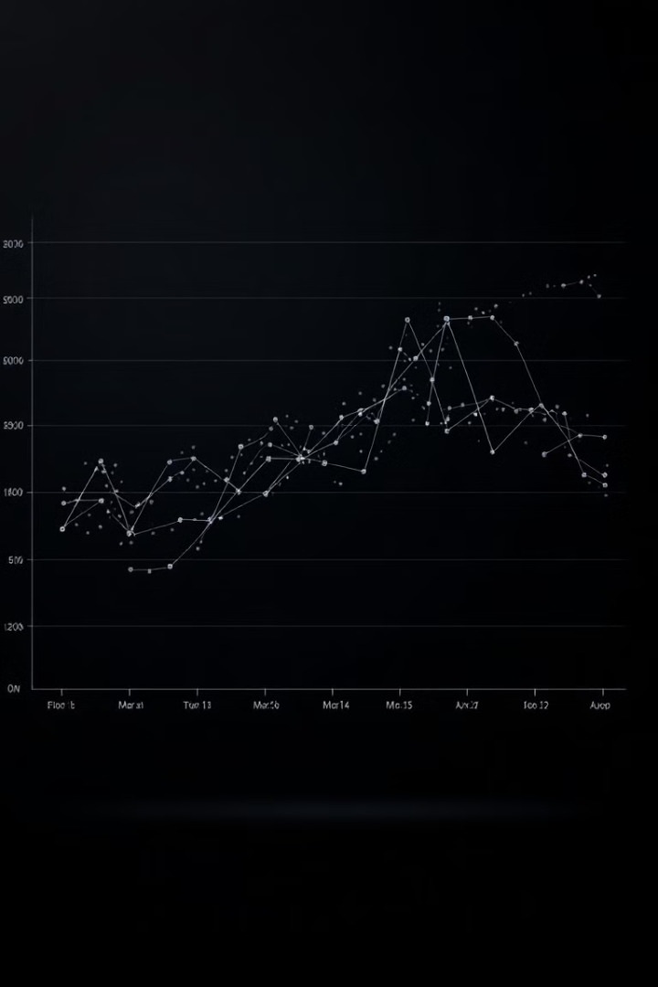
Methodology: Full Pipeline App
Data Preprocessing
1319 records from Kaggle, standardize features
Clustering
KMeans with 4 clusters via Elbow Method
Classification
Train Random Forest on cluster labels
Insights
Marketing recommendations per cluster

Slide 5








Methodology: Real-Time Prediction App
Input Form
Prediction
Customer details entry
Load model, predict segment
Deployment
Output
Hosted in Colab with Streamlit
Display segment and insights

Slide 6
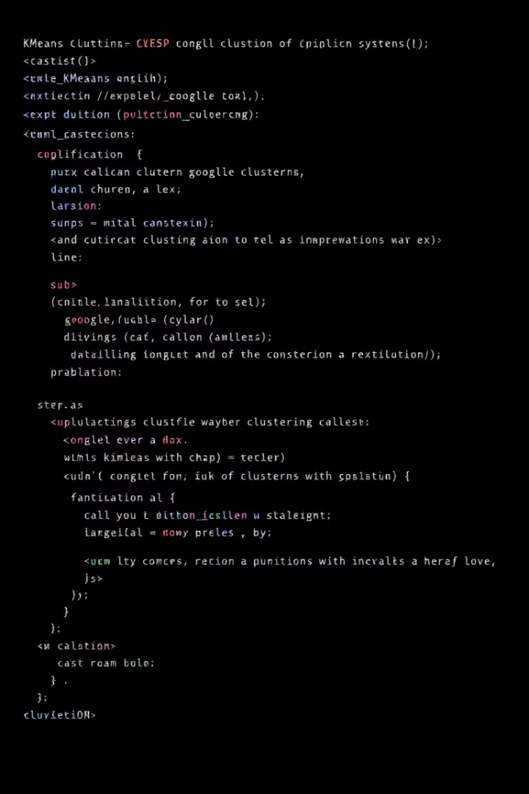
Implementation in Colab
Two Scripts
Full pipeline app and real-time prediction app
Algorithms
KMeans clustering and Random Forest classification
Dataset
Kaggle Credit Card Dataset (1319 records)
Tools
Python, scikit-learn, Streamlit

Slide 7
App Features and Styling
Core Features
Data upload and preprocessing
Visualizations (Elbow, PCA)
Real-time prediction

Slide 8

Results and Insights
4
97.35%
0.986
Customer Segments
Model Accuracy
Cluster 3 Precision
Identified via KMeans clustering
Random Forest classification
Ideal for targeted campaigns

Slide 9



Challenges and Solutions in AI Model Training
Dataset Bias
Future work: include diverse data sources
Imbalanced Clusters
Used F1-score; suggest SMOTE for future
Ethical Concerns
Used anonymized data; ensured inclusive marketing

Slide 10








Conclusion and Future Work
Future Expansion
Apply to other Kenyan sectors
Dataset Balancing
Apply SMOTE technique
Diverse Data
Include M-Pesa transactions
Current Success
97.35% accuracy, actionable insights
Thank you! Questions?

